Slide 1
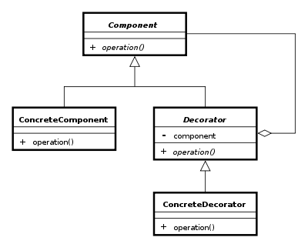
The Decorator pattern
Group 4 Asger Breinholm, Mathias Brændgaard and Rob Bertojo

Slide 2
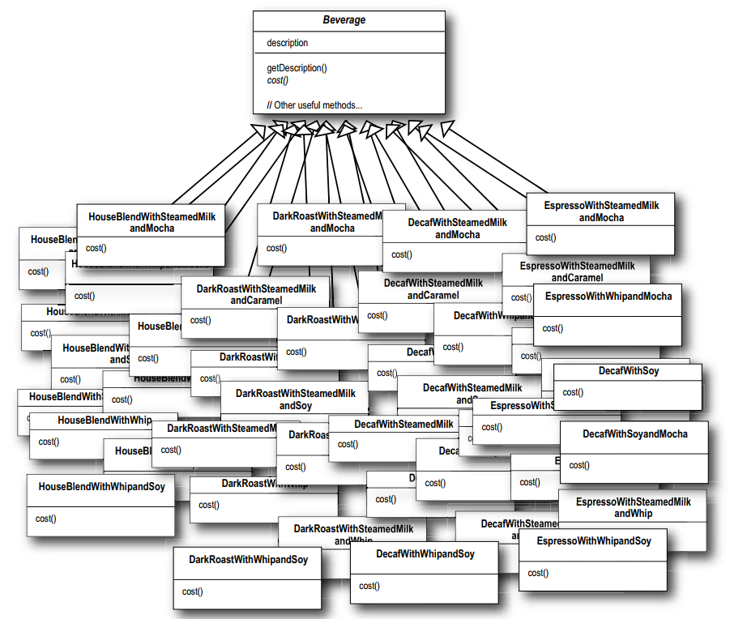


The problem
Subclass everything
Extension at runtime
* Head First, Design Patterns – Eric Freeman and Elisabeth Freeman with Kathy Sierra and Bert Bates

Slide 3
The solution – with Decorator

Slide 4
Pros & cons
Pros:
Less subclasses
Less memory usage
Cons:
More complex undo
More unnecessary code

Slide 5
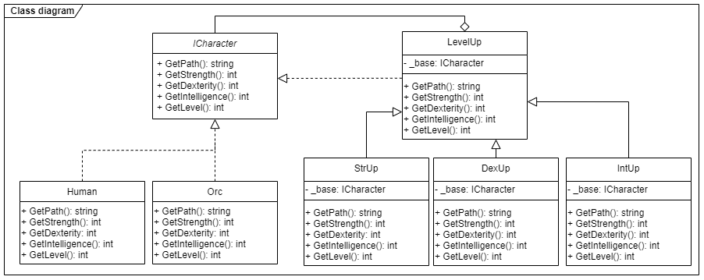
Class diagram

Slide 6
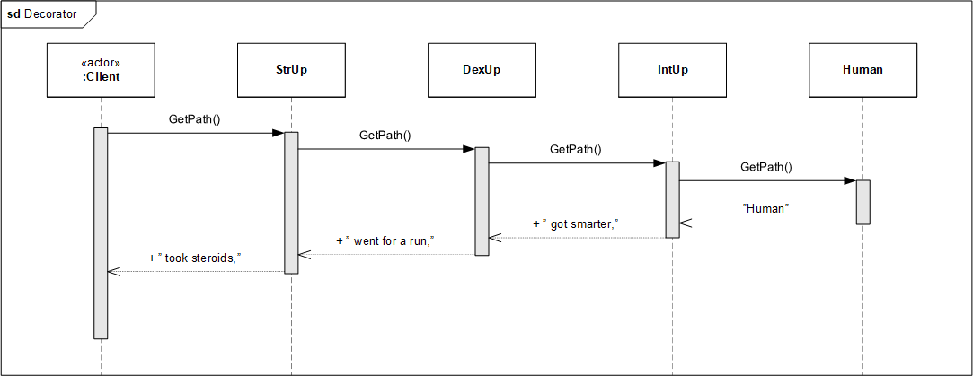
Sequence diagram

Slide 7
Our implementation
LevelUp base:
The decorator StrUp who inherits:

Slide 8
Comparison

Slide 9
Conclusion

